Slide 1
SEM
Lecture 6

Slide 2
What are we going to do today?
The quick summary of what you will do today is:
Open Amos.
Open your Amos model.
Run your model.
Interpret the model output.

Slide 3
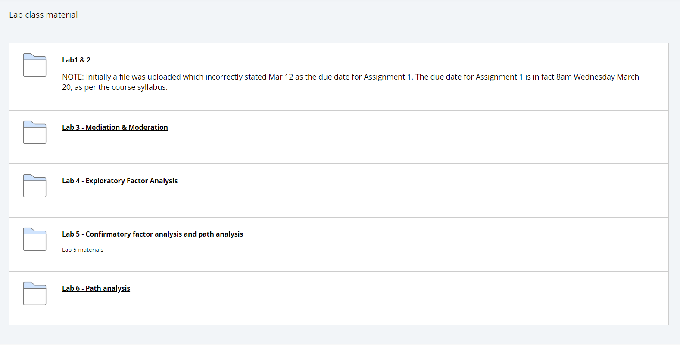
Download zip file from LMS

Slide 4
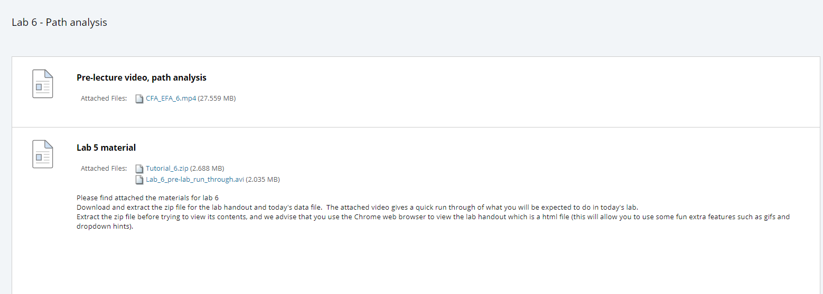
Download zip file from LMS

Slide 5

Unzip

Slide 6

Open that doc in Chrome

Slide 7
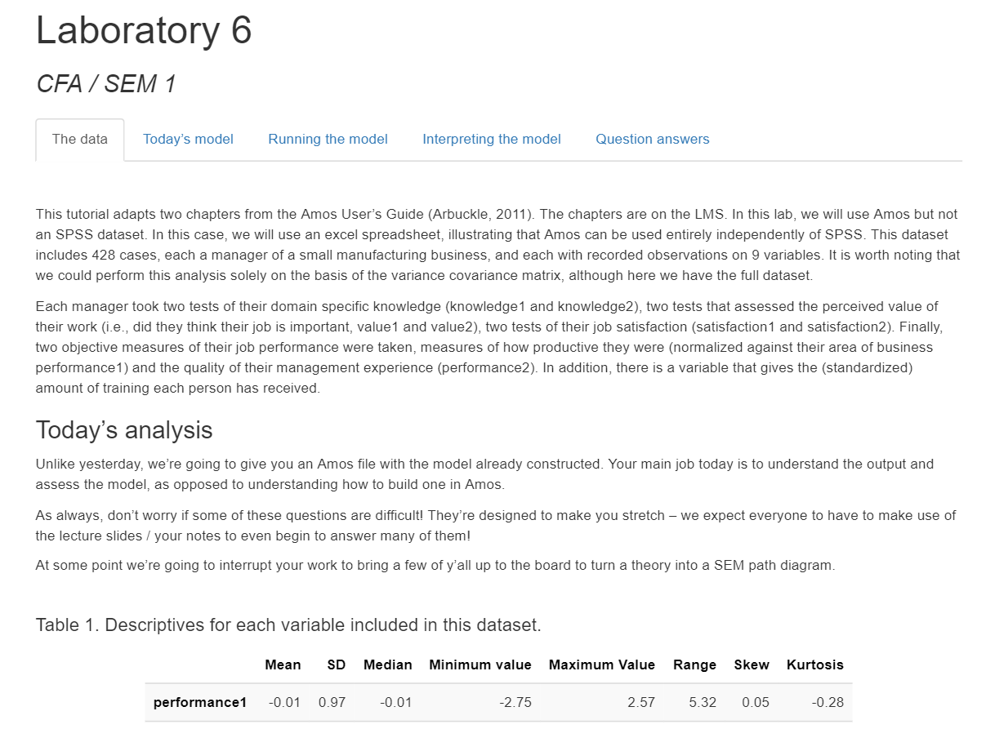

Slide 8
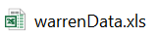
Todays wonderful very fun (management psychology) data

Slide 9
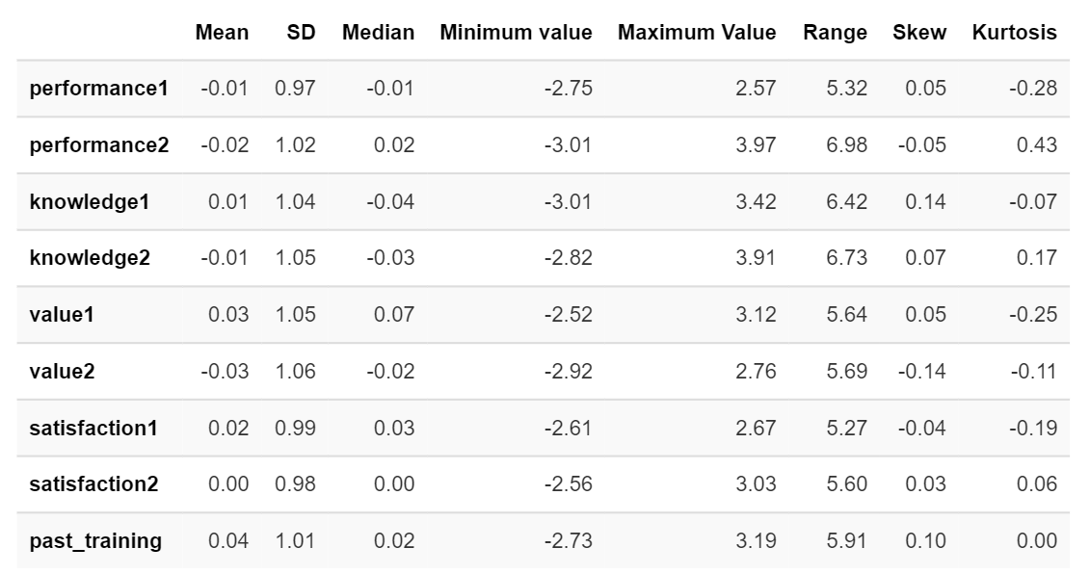
Todays wonderful very fun (management psychology) data

Slide 10
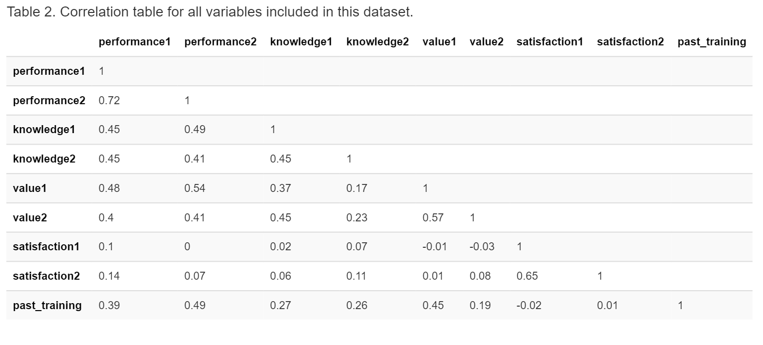
Todays wonderful very fun (management psychology) data

Slide 11
Todays wonderful very fun (management psychology) model

Slide 12
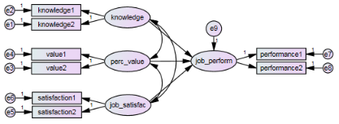
Todays wonderful very fun (management psychology) model

Slide 13
What does our very fun (management psychology) model actually mean?

Slide 14

If you could go ahead and run the model
That would be great

Slide 15
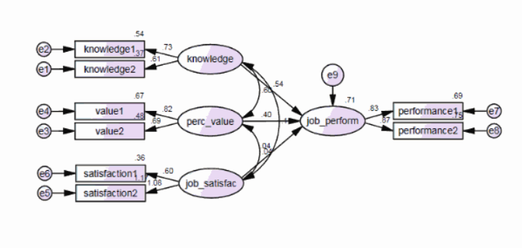

Slide 16
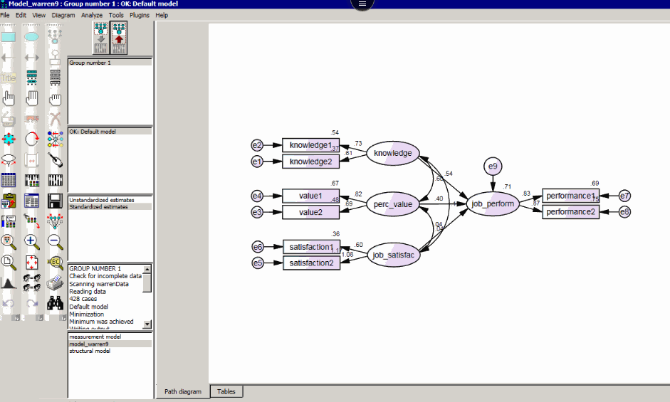
Check assumptions

Slide 17
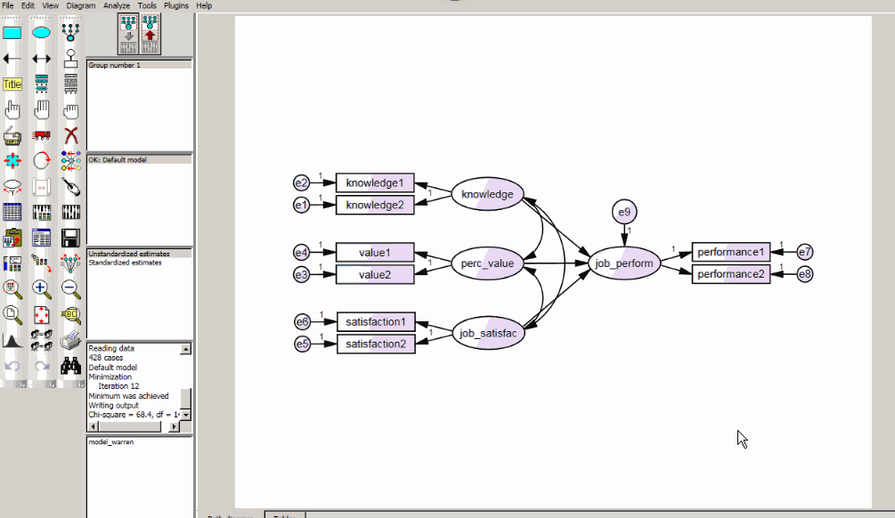
Check model fit

Slide 18
Interpret your model

Slide 19
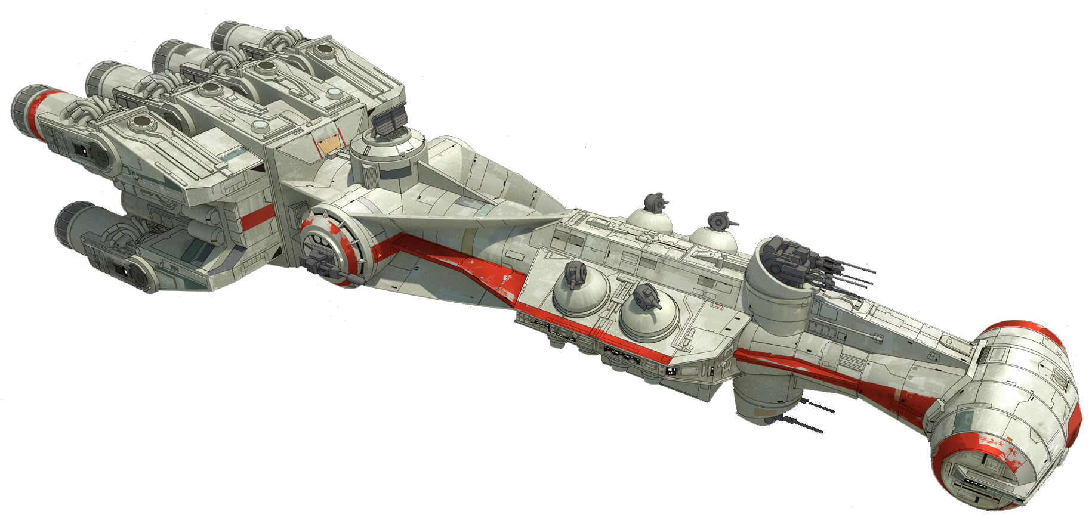
Interpret your model

